Slide 1
Making Server Calls and Persisting Data
Jon Galloway | Technical Evangelist
Christopher Harrison | Content Developer

Slide 2
Course Topics
Creating Dynamic Webpages With Knockout
01 | Introducing Knockout | 04 | Making Server Calls and Persisting Data
02 | Binding and Models | 05 | Single Page Applications
03 | Components

Slide 3
Knockout and Ajax

Slide 4
Entity Framework Overview

Slide 5
Entity Framework
Entity Framework (EF) is an object-relational mapper that enables .NET developers to work with relational data using domain-specific objects.
EF7 is cross-platform, more lightweight, and works with non-relational databases.
Not required for Knockout, we’re just showing it as an example.

Slide 6
Entity Framework Resources
https://github.com/aspnet/EntityFramework
Implementing Entity Framework with MVC
What’s New With ASP.NET 5 (EF7)

Slide 7
Loading Data

Slide 8
Loading Data via Ajax

Slide 9
Saving Data via Ajax

Slide 10
SignalR and Realtime Knockout

Slide 11

SignalR on Older Servers or Clients
Got Data?
Got Data?
Got Data?
Here’s some data!
Got Data?
Got Data?
Client
Server
Got Data?

Slide 12
SignalR on Modern Servers or Clients
I do real-time, do you?
Yep!
Let’s Party in Real-time!
Client
Server

Slide 13
SignalR Fallback
Long Polling
Forever Frames
Server Sent Events
Web Sockets

Slide 14
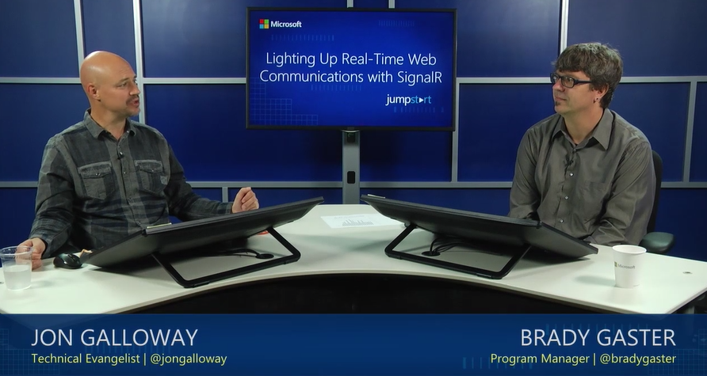
MVA: Lighting Up Real-Time Web Communications with SignalR

Slide 15
Saving and Updating via SignalR

